Slide 1

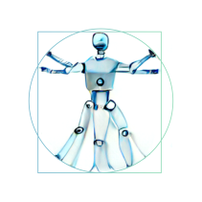

Digital Media, Society and Culture
Your Title Here
Student Name (s1234567)

Slide 2
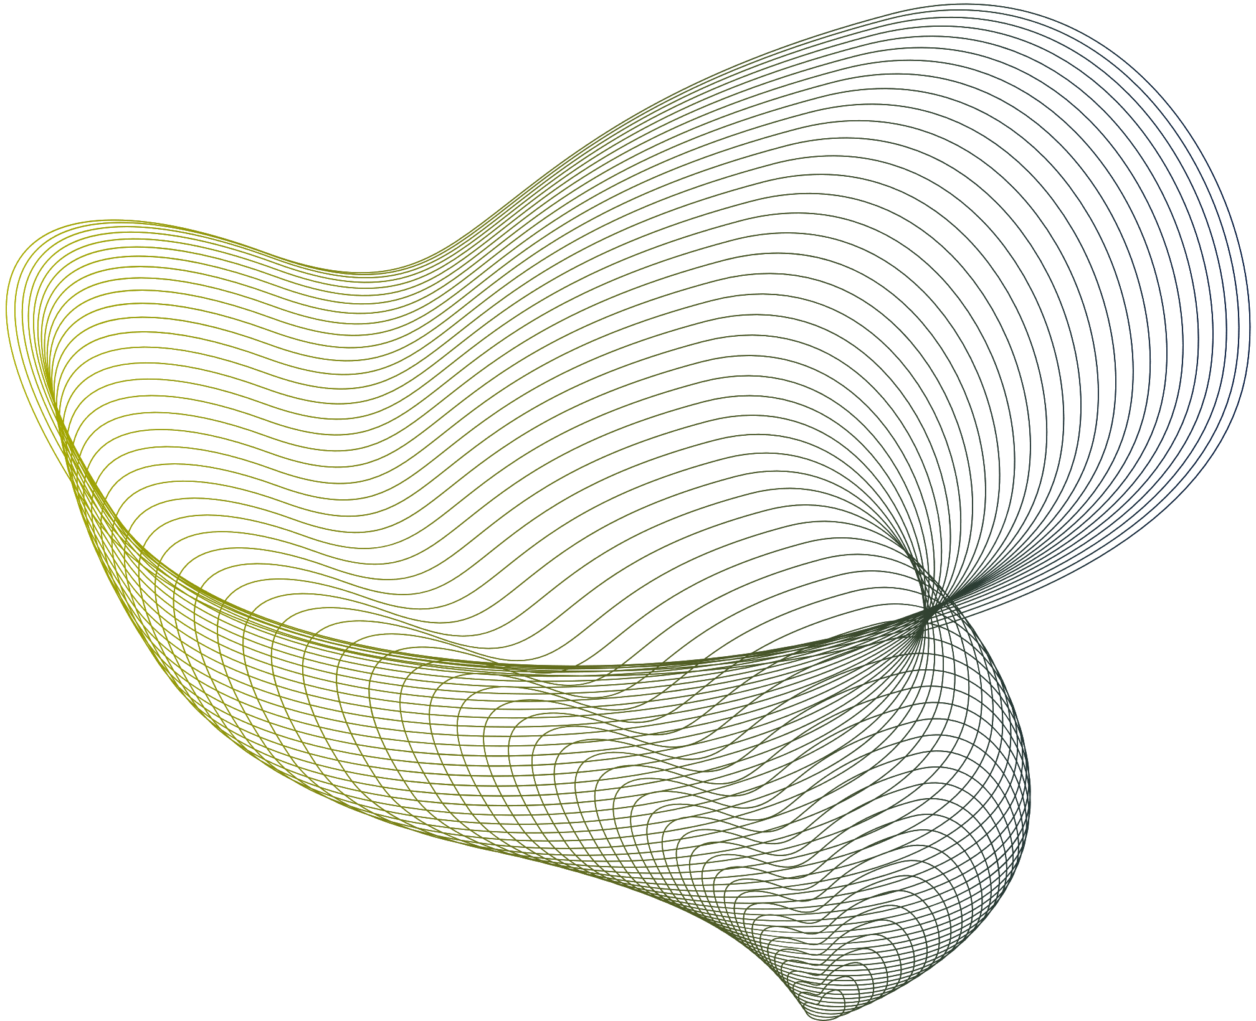
I predict that development X will happen to digital phenomenon Y in about Z time

Slide 3


Solution 1
Digital phenomenon Y is:
Tell us more about it in 280 characters or less, plus one image
In the presentation session, the background can be filled with information that is arranged systematically and effectively concerning an interesting topic to be used as material for discussion at the opening of the presentation session.
Source for the image

Slide 4
Solution 1
Current status of development X
(in digital phenomenon Y)
Tell us more about it in 280 characters or less, plus one image
In the presentation session, the background can be filled with information that is arranged systematically and effectively concerning an interesting topic to be used as material for discussion at the opening of the presentation session.
Source for the image

Slide 5

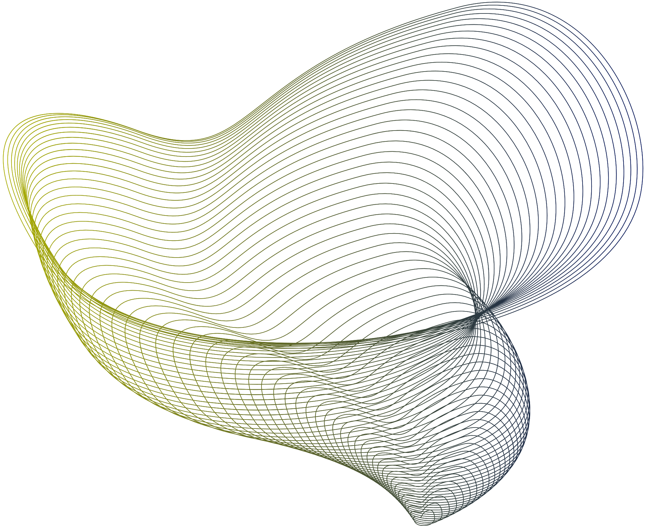
Reason(s) why you believe development X will happen in Z years
Tell us more about it in 280 characters or less, plus one image
Source for the image

Slide 6
Opinion on the effect of the development x
on phenomenon y (and why)
Tell us more about it in 280 characters or less, plus one image
Source for the image

Slide 7
More information
"The Art of Punnery: A Playful Analysis of Wordplay in Literature"
Smith, E. (2019). Journal of Linguistic Wit, 10(2), 88-101.
"Punderstanding History: A Tongue-in-Cheek Look at the Past"
Johnson, L. (2020). Journal of Punny Perspectives, 15(4), 207-219.
"The Puntastic World of Philosophy: A Philosophical Exploration in Punology"
Garcia, R. (2018). Journal of Witty Wisdom, 7(1), 45-58.
"In Puns We Trust: Exploring the Quirky Language of Rhetoric"
Thompson, S. (2021). Journal of Puntastic Discourse, 22(3), 120-135.
"Literary Lunacy: A Punspectacular Journey through Textual Territories"
Patel, K. (2017). Journal of Wordy Witticisms, 4(2), 75-88.
"Culture Puns: Unveiling Humor in the Humanities"
Wilson, M. (2022). Journal of Punny Perspectives, 12(4), 189-201.

